Slide 1
Type 1 diabetes immunotherapy Consortium - how children can get involved Talk given June 2018 to National Paediatric Diabetes Networks meeting, Leeds
Julie Edge
Cardiff University
thanks to Colin Dayan and Jane Bowen-Morris for some of the slides

Slide 2
Contact details….
www.type1diabetesresearch.org.uk

Slide 3
Agenda
Importance of C peptide
ITAD trial
USTEKID Trial
T1D consortium
How can we offer studies to all ND children?

Slide 4
Effects of preserved insulin (c-peptide)
C-peptide | HbA1c | % < 7.5 | Insulin (U/kg/d)
< 0.04 | 8.49 | 18.4 | 1.07
0.04-0.2 | 8.10 | 32.3 | 1.08
> 0.2 | 7.47 | 51.9 | 0.93
Sorensen et al 2013

Slide 5
Risk of severe hypoglycaemia in Danish children
Sorensen et al 2013
Stimulated c-peptide
(nmol/L)

Slide 6
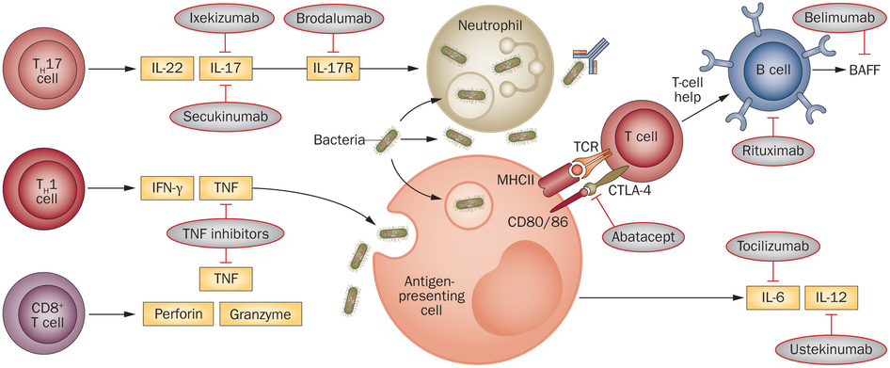
The immune system
Very complicated – but multiple possible target chemicals

Slide 7
Different types of immunotherapy
Treatment | Example | Risk of side-effects
General Immunosuppression | Drugs use for organ transplants | High
Selective immunosuppression | Newer drugs used for example in arthritis, skin diseases | Low
Boosting immune regulation | “vaccines”, protective cells, drugs to boost protective cells | Very low

Slide 8
How is immunotherapy given?
Usually as an injection, iv, im, sc
A course of injections or treatments every week, month or three months.
Many of the treatments are already licensed for use in other diseases (e.g. arthritis, skin disease, multiple sclerosis)
GIVEN WITHIN 3 MONTHS OF DIAGNOSIS – when there is still insulin left….

Slide 9
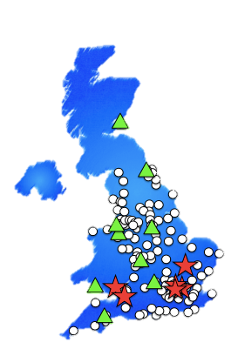
The Consortium
Clinical Engagement and Recruitment
Mechanistic Core
Address-2
T1D
UK

Slide 10
ITAD Interleukin 2 Therapy of Autoimmunity in Diabetes
Interleukin 2 (Aldesleukin©)
At ultra-low dose, aldesleukin increases numbers of regulatory T cells (Tregs)
Preliminary clinical evidence that IL-2 therapy can arrest the autoimmune-mediated destruction of pancreatic β cells by induction of functional Tregs that inhibit islet-specific autoreactive effector T cells (Teffs).
Side-effects limited to local skin reactions

Slide 11
ITAD Interleukin 2 Therapy of Autoimmunity in Diabetes
Randomised placebo controlled trial; 2:1 randomisation
To assess the effects of ultra low-dose aldesleukin on beta-cell function
Age eligibility 6-18 yrs
Recruitment within 6 weeks post-diagnosis
Target recruitment 45 patients
Treatment duration: twice weekly for 6m & 6m follow-up
7 study visits (hosp)
Plus twice weekly home visits for 6 mths
7 sites 7-8 pts per site
18 mths recruitment period

Slide 12
6-month treatment period
Visit 1 screening
Visit 2
Randomisation
Visit 3
1 month
Visit 4
2 months
Visit 5
3 months
Visit 6
6 months
Inclusion/exclusion
Medical & family history
Concomitant medications
Clinical data
C-peptide,
Treg levels, TBNK FACS assay, PBMC,
Safety blood tests
insulin dose data, HbA1c
Clinical data
DBS for C-peptide
Treg levels, TBNK FACS assay, PBMC
Insulin dose data
Safety blood tests
HbA1c (only 5 and 6)
Adverse events
Post treatment follow up
Twice-weekly home visits for medication
Weekly in-between visits: home DBS for C-peptide
Treatment to be started at visit 1 or within 7 days from this visit in a hospital setting
Visit 7
12 months
Clinic data,
DBS for C-peptide,
Treg, TBNK FACS assay, PBMC
Insulin dose data, HbA1c
7-12 months: monthly DBS

Slide 13
Ustekinumab (Stelara©)
Humanised IgG1 monoclonal antibody that binds to the common p40 subunit protein of IL-12 and IL-23, required for the generation of Th1 and TH17 cells.
Side-effects –
well-tolerated,
licensed for use in children

Slide 14
Ustekid Study design
72 adolescents age 12-18, dosed within 100 days of diagnosis
2:1 intervention:placebo randomization
Ustekinumab (Stelara) or matched placebo saline to be given s.c. at 0, 4, 12 weeks then q 8 weekly up to week 52.
Study across 15 UK paediatric and adult centres
Each centre (recruit 3-4 per year)
12-15 yr olds, screen 4-6/yr, recruit 2-4/yr
16-18 yr olds, screen 2-3/yr, recruit 1-2/yr
Referrals from ADDRESS-2 also
Likely start – Q2 2018, to run to Q2 2020

Slide 15
Outcome measures
Primary Outcome: Comparison of AUC c-peptide at week 52 in standard MMTT adjusted for baseline values between intervention and treatment groups.
Secondary Outcomes:
AUC C-peptide measured at 28 weeks
Insulin use in units per kg body weight per day
HbA1C levels at weeks 0, 12, 28 and 52.
Hypoglycaemia:
trial diary.
glycaemic variability as assessed by Flash Glucose monitoring download for 14 days prior to each assessment
C-peptide –
home-sampled DBS C-peptide levels
spot urine (urine C-peptide/creatinine ratio - UCPCR) samples 2 hours post main meal on 3 occasions every month.
PROMS

Slide 16
Supply vs Demand (new onset T1D)
In UK:
age 5-17 years: 2000 cases/year
age 18 + years: 1500 cases/year
20% capture =
300 new-onset adult cases/year
400 new-onset child cases/year
ITAD – 45
Ustekid – 72 but struggling to find enough centres

Slide 17
The 20% - 20% Challenge
Can we achieve 20% of eligible referred patients being referred
Then 20% of referred patients entered into an intervention trial?
would be 80 CYP per year – not enough, if multiple trials available
But actually need 50 / 50 challenge – how??

Slide 18
Consortium sites
Initial 15 paediatric sites chosen with combined adult centres
Now involved almost all regional paediatric centres
Many doing CLOuD study – should finish early 2019
SO should be possible to obtain numbers
Ustekid start late 2018
ITAD probably early 2019

Slide 19
17 T1D UK Research Centres
29 teams
16 Paediatric teams
13 Adult teams
More Paediatric teams interested

Slide 20
Future plans
Aim is to develop standardised protocols for all immune therapies
Looking at outcomes – MMT unpleasant and insensitive
DBS C-peptide
CGM BG variability
insulin dose
HbA1c
Aim for more rapid answers in fewer patients
Continuous stream of studies
Consortium to be the method for Pharma to carry out their studies
composite measures

Slide 21
Could we offer to all CYP?
How could we offer opportunity to ALL ND CYP?
Through regional links?
PIC sites?
Participant Identification Centres
don’t have contracts and carry out studies, identify patients and refer on
how would clinical care be managed?

Slide 22
Discussion at meeting
Keen interest in the studies
Parents present keen to spread the word
Very important to inform newly diagnosed families as soon as possible –
through Digibete?
through Parents with Diabetes Network website
Regional networks all have research leads
Send presentation out to all networks to research leads
Challenges –
how to work with Clinical Research Networks
do all pharma studies come through the Consortium?
NIHR needs to know to contact Consortium as first line

Slide 23
Contact details….
www.type1diabetesresearch.org.uk

Slide 24
Ustekid - Inclusion Criteria
Clinical diagnosis of Type 1 diabetes
≤100 days between the diagnosis and the first treatment dose.
Commenced on insulin within 1 month of diagnosis.
Written and witnessed informed consent/assent to participate.
Male or female, aged 12-18 years inclusive at the time of randomisation.
Body weight < 100kg.
Willing to record all insulin doses and blood glucose levels required for monitoring during the
study, including reporting any hypoglycaemic events.
Female participants have a negative urine test for pregnancy; all sexually active participants
must agree to use adequate contraception
TO BE EVALUATED AT SCREENING:
Evidence of residual functioning beta-cells (serum C-peptide level > 0.2nmol/L in the MMTT
Positive for at least one islet autoantibody (GAD, IA-2, ZnT8).

Slide 25
ITAD Inclusion Criteria
Written informed consent/assent with parental consent
Be aged 6-18 years
Be diagnosed with T1D (at least one autoantibody positive), requiring insulin treatment
Be within 6 weeks from diagnosis of T1D
Have a random C-peptide > 200 pmol/l
Normal full blood count

